Slide 1
Project Management

Slide 2
Team members
Anusha Acharya
Deepa Anchan
Nidarsh N
Nisha Sharma
Sonali S
Vaishnavi K L

Slide 3
introduction
The main objective of this project is to manage project assignment to the employee and track its progress.
Admin is responsible of creating the project and assign it to the manager who is available . Admin creates a separate git repository for each project .
Manager can work only on single project at a time. Once project assigned he/she will have the authority to create the task and subtask and assigning it to the employees depending on the skills.
Employee will make an updates of the work he/she is has done and the same will be updated on git.

Slide 4
Problem statement
Create project, assign to manager
Create task and subtask. Assign subtask to avaiable employee depending on required skill
Interactive approach to track project progress!

Slide 5
Scope of the project
This application will help organization to manage projects efficiently and effectively.
This application can be accessed only by the authorized and authenticated persons.
Application provides data security.

Slide 6
Technology stack used
Front End
HTML
CSS
BackEnd
MySQL
MongoDB
Middle Ware
JAVA 8.x
SPRING 5.1.9
JAVASCRIPT
TYPESCRIPT
BOOTSTRAP 4
ANGULAR 8
SPRING BOOT 2.1.8
EUREKA DISCOVERY CLIENT
HIBERNATE
JPA
LOMBOK
ZUUL

Slide 7
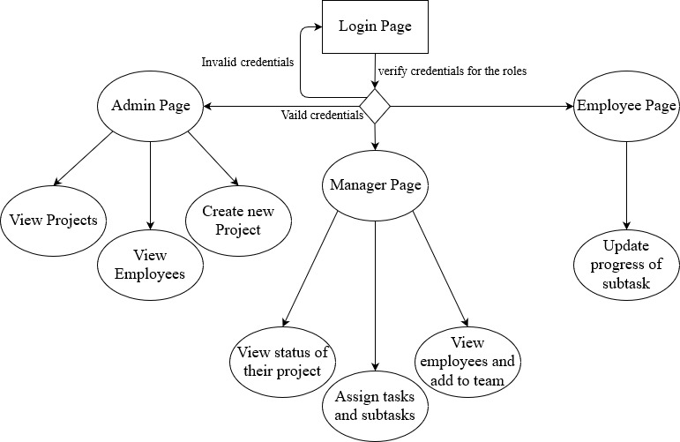
ANGULAR ARCHITECTURE

Slide 8
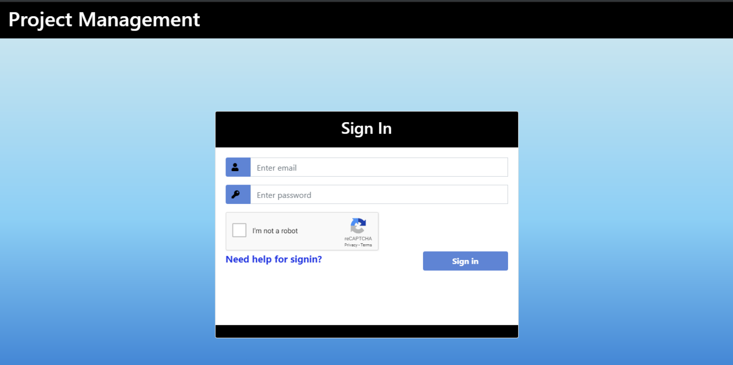
Let’s get INTO THE PROJECT

Slide 9
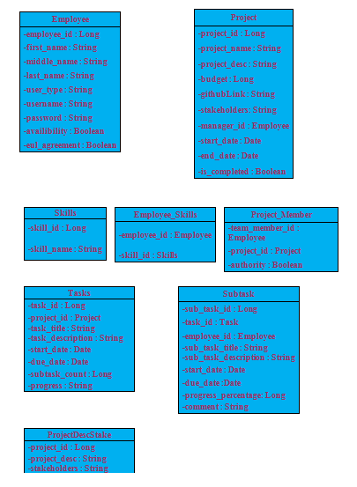
DATABASE ARCHITECTURE

Slide 10
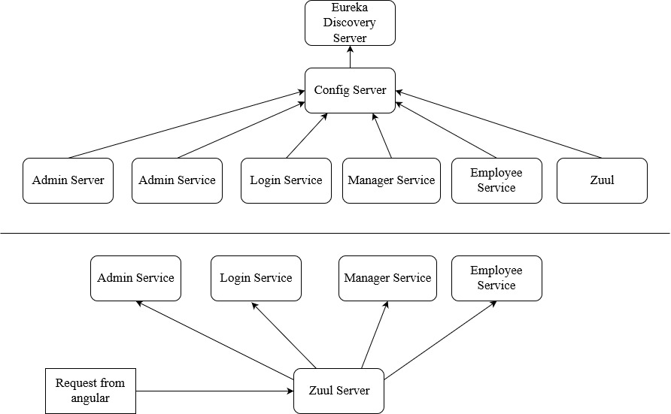
MICROSERVICE ARCHITECTURE

Slide 11
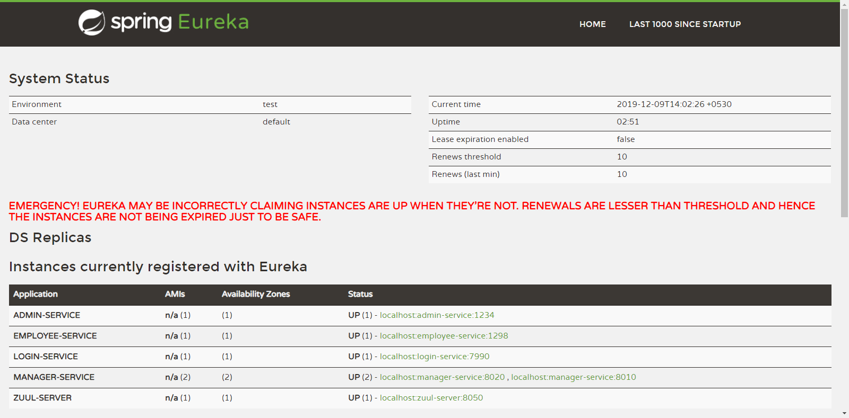

Slide 12
DEPLOYMENT
AWS
Mongo Atlas
Pivotal Cloud Foundry

Slide 13
TESTING
MOCKITO

Slide 14
THANK YOU

